Slide 1
INTRODUCTION TO PHYSIOLOGY
DR RESHMY K. R
ASSOCIATE PROFESSOR
DEPT. OF PHYSIOLOGY &BIOCHEMISTRY

Slide 2
PHYSIOLOGY -The science that is concerned with the functions of the living organism and its parts, and of the physical and chemical processes involved.
Latin word Fizzeeo (physio)-nature ; Lozee ( Logia)-knowledge –Natural knowledge or nature –a study of natural functions of body.
Word originated from a Greek root 'physiologikos'- “discourse on natural knowledge”
Physiology
Notes:
Physiology is the science that is concerned with the function of living organisms and its parts, including the physical and chemical processes involved.
In this course, we will be concerned mainly with human physiology, although as we will see much of our knowledge of human physiology is based on experimental studies in animals.

Slide 3
Physiology: biological sciences
dealing with the normal life phenomena exhibited by all living organisms.
Human physiology: basic sciences
dealing with normal life phenomena of the human body, their principles, their mechanisms and their control.
Goal of physiology:
explain the physical and chemical factors that are responsible for the origin, development and progression of life.

Slide 4
Human Physiology
Physiology: (Greek) The study of nature, the involvement of Physics and Chemistry,and Anatomy.
The basis for
Pathophysiology
Pharmacology
Immunology
Biochemistry
Microbiology

Slide 5
PATHOPHYSIOLOGY
The study of disordered body
function (i.e. disease)
The basis for clinical medicine
Notes:
We will also be discussing, to some extent, pathophysiology which is the study of disordered body function, or disease, and is the basis for clinical medicine. We will not have as much time as we would like in this course to discuss the pathophysiology of disease. This will be covered in the 2nd, 3rd, and 4th years of you medical training, but we will throughout the course use clinical examples of pathophysiology to help illustrate physiological functions.

Slide 6
Why do we study Physiology?
Understand the physiologic principle underlie normal function in order to cure the impairments.

Slide 7
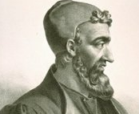
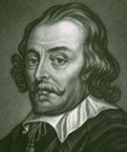
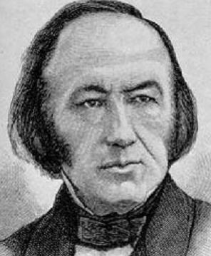
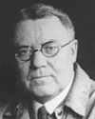
History of Physiology
Arist (384 – 322 BCE) – speculated on body function
Erasistratus (304 -~250 BCE) considered the father of physiology - applied physical laws to the study of human function
Galen (130 -201 A.D.) - believed the working body was not understandable without knowledge of its structure
William Harvey (1578–1657)-blood pumped in a closed system of vessels
Claude Bernard (1813 – 1878) – internal environment remains constant despite everchanging external environment
Walter Cannon (1871 – 1945) – coined the term ‘homeostasis’

Slide 8
Medical science is a branch of biological science which deals with health ,disease and treatment in human beings and animals. With the development of human community men gradually became conscious about bad health and the “art of healing” The first evidence about the art of healing is from China,2500BC and in Rome 600BC. Evidence in writing is from Indian Ayurvedic medicine 600BC-Charaka and Sushruta
Notes:
ffgghjhjhk

Slide 9
Hippocrates 460-377BC, a Greek physician is the Father of medicine.-He proposed the highest moral and ethical inspiration for physicians “Hippocratic oath”
Erasistratus 300-260BC,was the Father of Physiology .The observation and explanations given by him in respect with Anatomy, Physiology of heart, lungs, vessels, GIT, spinal nerves, muscular contractions and hunger-adorned him as the father of Physiology .

Slide 10
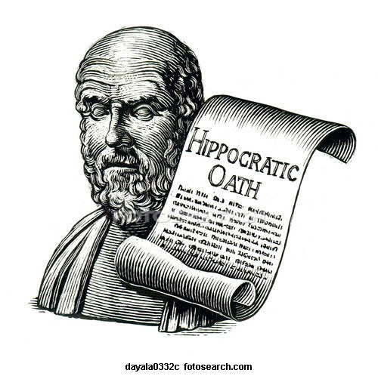
Hippocrates
Erasistratus

Slide 11
Jean ferral 1552,a French lady scientist derived the word Physiology from the Latin word Fizzeeo (physio)-nature ; Lozee ( Logia)-knowledge –Natural knowledge or nature –a study of natural functions of body.

Slide 12
With each discovery in physics and chemistry physiologist explained many mysteries of human body.
Physiology is defined as the study of phenomenon presented by living organisms, the classification of these phenomenon and recognition of their sequence and relative significance, the allocation of every functions to it’s appropriate organ,the study of the conditions which determine each functions.

Slide 13
In 1726,physiology was recognized as part of medical curriculum and Mr.Andrew sinclair who was appointed as Pro.in physiology-Institute of medicine in Edinburgh.

Slide 14
Claude Bernard (1813-1878) a French physician was “the father of Experimental medicine “.
Apart from advocating the use of medicine after experiment, he studied body functions extensively.

Slide 15
He postulated that survival of a cell depends on a balance between ‘milieu internous ’ and ‘milieu externous’ , that is uniformity which results from the adjustment of living being to change in their environment or maintaining homoeostasis .
He called pulse, BP, respiration, digestion, excretion etc as dynamics of life while the triad of life is nutrition, protection and reproduction

Slide 16
Knowledge regarding anatomy will simplify an understanding of physiological processes.
Hence a sound knowledge of physiology is essential for understanding and managing various disorders.

Slide 17
THANK YOU

